Slide 1
GIC Team 9
Asher
Jung Yi
Jun Xiang
Jing Xuan
Drustan
Notes:
Talk about parts that we did not mock (Auth, Server update)

Slide 2





Meet the Team!
Drustan Yeo
NUS Y3 CS + Math
(Backend)
Ong Jing Xuan
NTU Y4 REP CS
(Frontend)
Asher Laiu
SMU Y3 Econs + IS
(Backend)
Heng Junxiang
NUS Y3 Comp Eng
(Frontend)
Ong Jung Yi
SUTD Y3 CS
(Backend)

Slide 3
Table of contents
Tech Stack
Live Demo
1
2
User Stories
Architecture & Design
3
4
React, Spring Boot, MySQL
Pray for us :)))
In-depth analysis
Microservices

Slide 4
1
Tech Stack

Slide 5



Tech Stack
Next.js
Spring Boot
MySQL
React.js
TailwindCSS
Material UI
Spring Security
Spring Cloud Gateway
Server Sent Event
Lombok
Spring Data JPA
Adminer
Docker

Slide 6



Next.js
1
Declarative UI
2
Component-based
3
Clean Styling
4
Consistency

Slide 7
Spring Boot
1
Spring Ecosystem
2
Embedded Servers
3
Microservices Support

Slide 8
2
Live Demo

Slide 9
3
User Stories

Slide 10
User Story 1 & 2
System returns exact matches within 3s
Department validation through authentication
Request Form
Analysis: Trader searches for verified instruments and sends request for new instruments that are not present

Slide 11
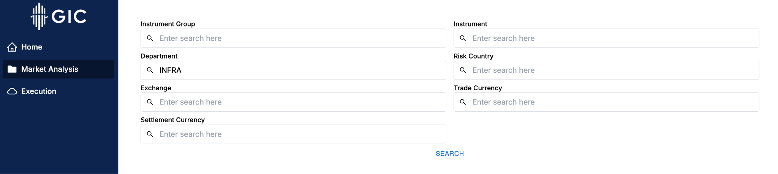
UI Component

Slide 12
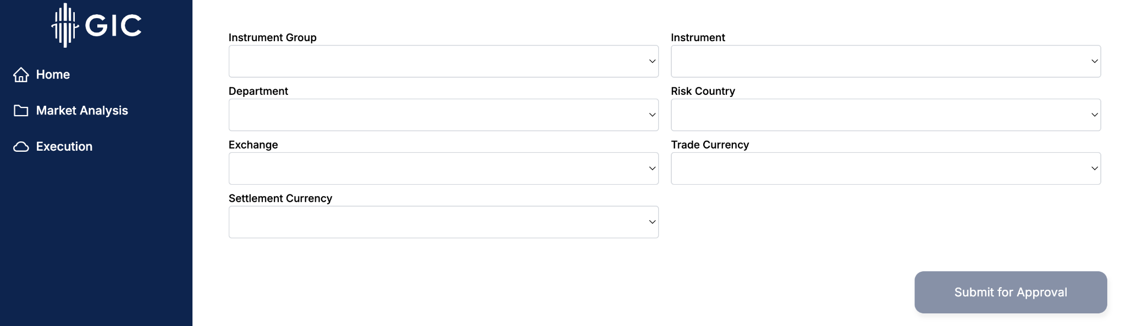
UI Component

Slide 13

Efficient Querying of DB
Use only one API call for multiple search fields
Reduces API calls to DB

Slide 14
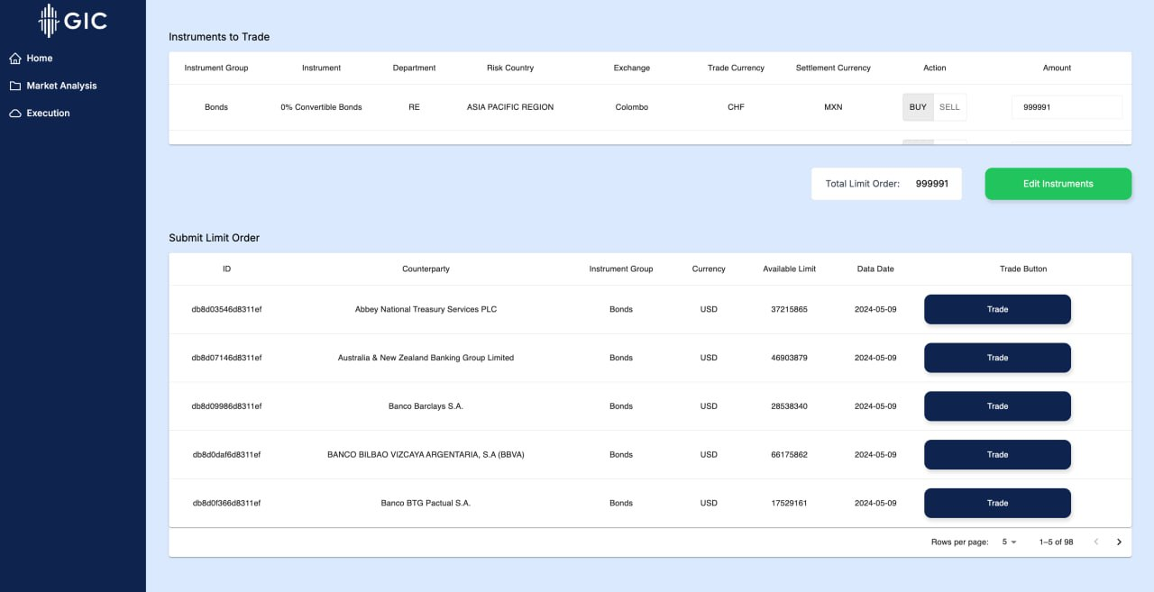
User Story 3 & 4
Execution: Trader uses a reliable Real-time Limits Dashboard for Executing Trades Concurrently

Slide 15
UI Component

Slide 16
Integration With DB
SSE To Receive Live Updates
Orders Are Queued
Backend Check To Prevent Overuse

Slide 17
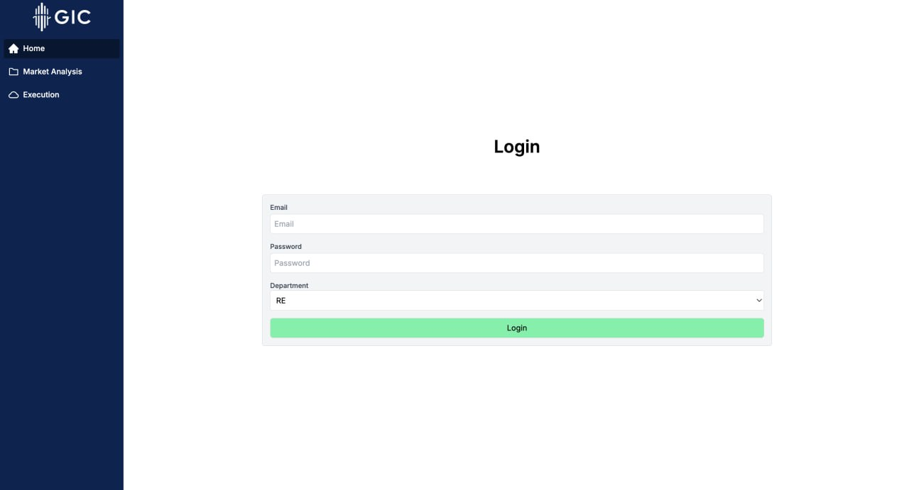
User Story 5
Integrated Platform: All-in-one webapp for Traders

Slide 18
UI Component

Slide 19
4
Architecture & Design

Slide 20
What is Microservices Architecture?
Microservices architecture breaks down an application into independent, modular services that each handle a specific functionality.
Each service is developed, deployed, and scaled independently, while communicating with others through APIs.

Slide 21
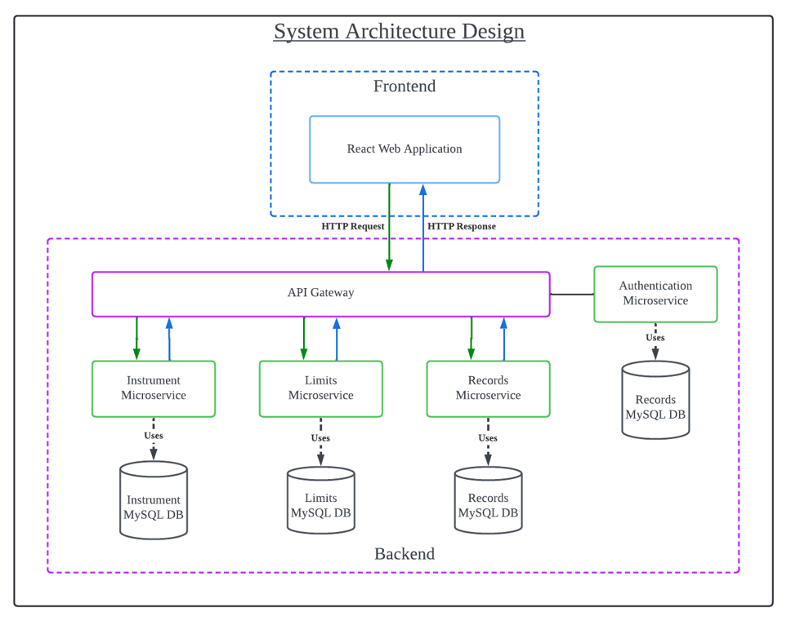

Slide 22
API Gateway: Centralized routing point, handling authentication and traffic distribution to individual services.
Authentication Microservice: Secures the system using JWT, applied once for all services through the API gateway.

Slide 23
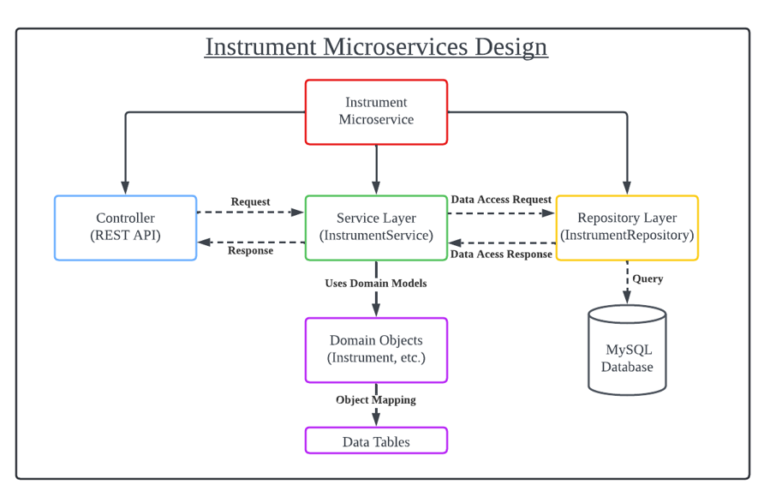
Instrument Microservice: Handles instrument search and queries.
Limits Microservice: Manages limit tracking and trade execution.
Records Microservice: Logs trade approvals and user actions.

Slide 24

Pros
Scalability: Each service can be scaled independently based on usage demand.
Flexibility: We can deploy and update services without affecting the entire system.
Resilience: If one service fails, others continue to function, reducing downtime.

Slide 25
Cons
Complexity: Managing multiple services introduces complexity in terms of deployment, monitoring, and communication between services.
Overhead: Requires additional infrastructure and careful management of service-to-service communication.

Slide 26
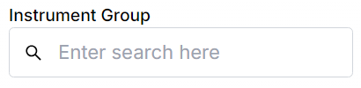
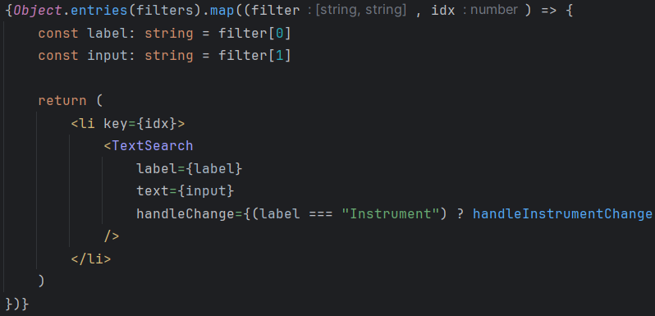
Frontend Code Design
Component-Based Architecture
Reusable, self-contained UI components that manage their own logic
System is modular and maintainable

Slide 27
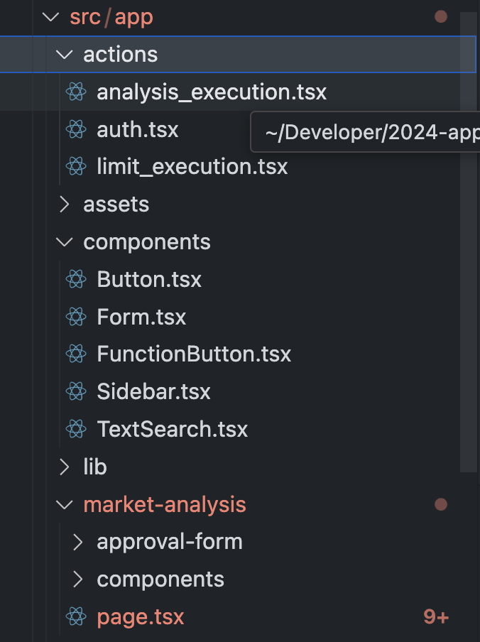
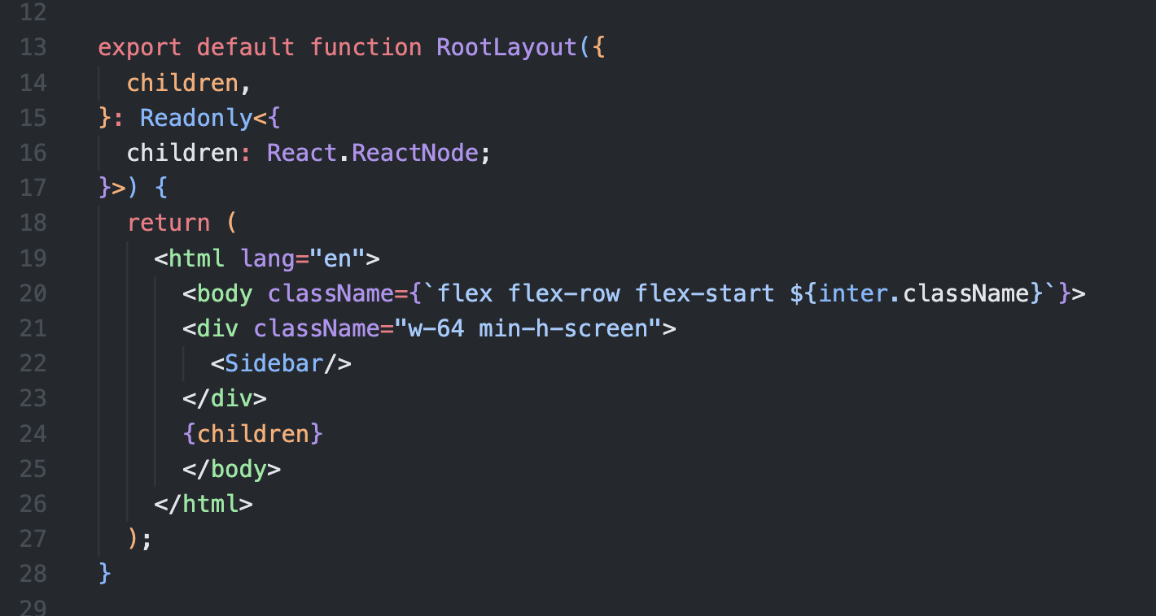
Frontend Code Design
Separation of Concerns
Code Reuse and Consistent Styling
Divides UI components into two types:
Container: Handles data fetching, logic, and state management.
Presentation: Receives data via props and focuses solely on UI display.
Keeps code clean and consistent
Reusable components
Nextjs layout tools
Tailwindcss configuration
Material design guidelines

Slide 28
THANK YOU!

